Slide 1

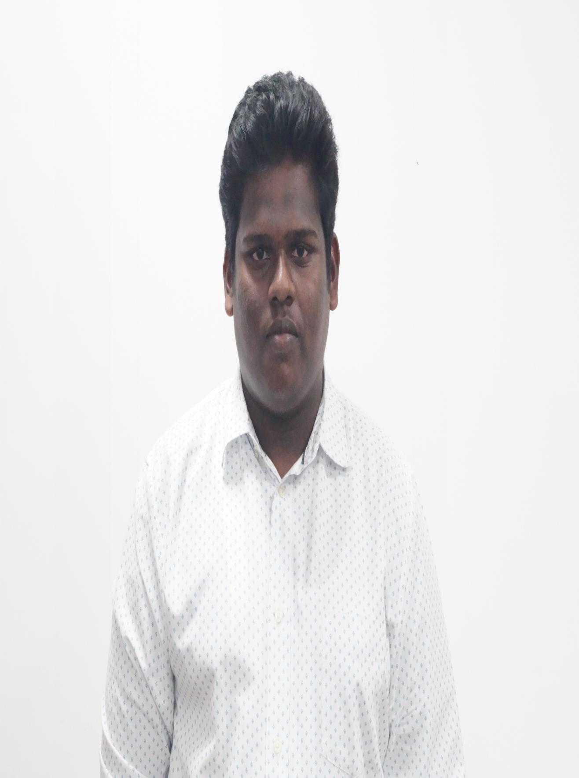
Name:BANDILA SUJITH
Register Number:192021012
I Year
Institute of Information Technology and Engineering

Slide 2
Slot C | Total Marks | Marks Obtained | Class Average Mark
Test 1 | 30 | 20 | 26
Test 2 | 30 | 30 | 27.5
Test 3 | 30 | ab | 23

Slide 3
Dear parent
He has attended mentor mentee meeting which was conducted on 03.09. 2022. He has to improve his marks and aim for S grade for slot C and D and he has not reported test marks to me. He must start attending seminars and webinars to improve his communication and technical skills. He must be regular to all slots lab sessions. Good that he has registered for NPTEL courses. Attendance is compulsory for mini project ( Product design and development)

Slide 4

MENTEE RESPONSE
PARENTS RESPONSE
I WILL DO MY BETTER
improve in studies

